Slide 1

Problem Statement
Responsible consumption and recycling are important factors of sustainable living. However many South Africans lack the know-how that would allow them to live sustainably. This includes:
Knowledge on what and how you can recycle in South Africa
How our individual ways of living effect the environment (carbon footprints)
How to change our consumption patterns in a way that is useful
UN Sustainable Development Goals
Goal 12
Ensure sustainable consumption and production patterns
12.8 By 2030, ensure that people everywhere have the relevant information and awareness for sustainable development and
lifestyles in harmony with nature
Goal 13
Take urgent action to combat climate change and its impact
13.3 Improve education, awareness-raising and human and institutional capacity on climate change mitigation, adaptation, impact reduction and early warning

Slide 2

Technology Used
Our solution makes use of a web application using the following coding languages, modules and open-source code:
Language | Modules | Open-Source Code | Where
Python | Django | N/A | Backend
HTML | N/A | N/A | Frontend
CSS | N/A | Bulma.io | Frontend
Quiz created using Interact (https://www.tryinteract.com/?gspk=c2VtYW50aWNsYWJz&sid=1-g-Cj0KCQjwpZT5BRCdARIsAGEX0zmgOtrz0iScpfDjSIhuxxfksa4jnjifWto-pFibtNe6HBcNAkSs2sIaArRFEALw_wcB&gclid=Cj0KCQjwpZT5BRCdARIsAGEX0zmgOtrz0iScpfDjSIhuxxfksa4jnjifWto-pFibtNe6HBcNAkSs2sIaArRFEALw_wcB)

Slide 3
SOLUTION
Octopus… A web application that provides information on what and where you can
recycle in South Africa in easy to understand language. Further, the application has the
capability to calculate an individual's carbon footprint and ranks users to encourage healthy competition in living more sustainably. Octopus can be broken down into five main functionality screens for users to interact with:
Homepage
Users can navigate to different parts of the application from here and a brief introduction
is provided. Users would register and/or login here in future versions to allow them to save
information and/or carbon footprint scores.
Recycle Page
On this page, users can search for the item they wish to recycle. The application will provide information on whether the item is recyclable and if so, how and where to recycle it.
Carbon footprint Page
Here, the user is asked several questions to calculate their individual carbon footprint. Information on how to improve this is also provided and in. future, we would like to rank user’s scores in relation to other users.
Why Recycle? Page
This page provides information on the impact of waste on the environment and
why individuals and companies should recycle.
community Page
Here users can post their own tips on recycling and sustainable living. This will allow users to have a sense of belonging and act as a sort of support system in terms of sustainable living.

Slide 4
What makes
this SOLUTION
Unique?
It consolidates a large volume of information into simple, concise and easy to understand language. This will allow for information on recycling to be more accessible to the general public and hence makes it easier for more people to understand what they can recycle as well as where and how to recycle it.
ONE
The carbon footprint calculator is a tool that currently is not easily accessible to individuals. This tool allows users to understand the impact of their patterns and behaviour's on the environment. Through this, the application allows users to engage better with content regarding sustainability and further encourages users to live more sustainably.
TWO

Slide 5

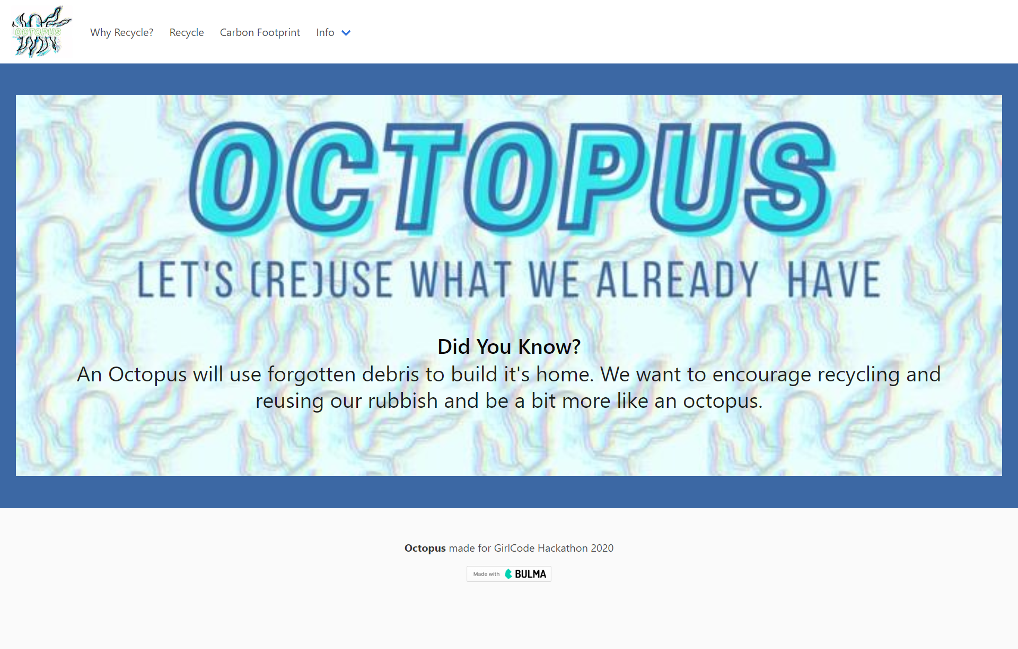
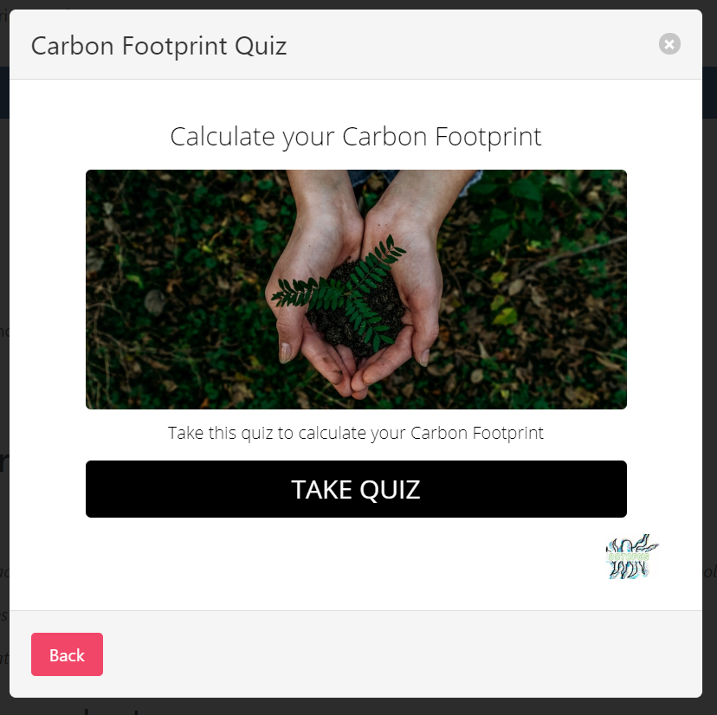
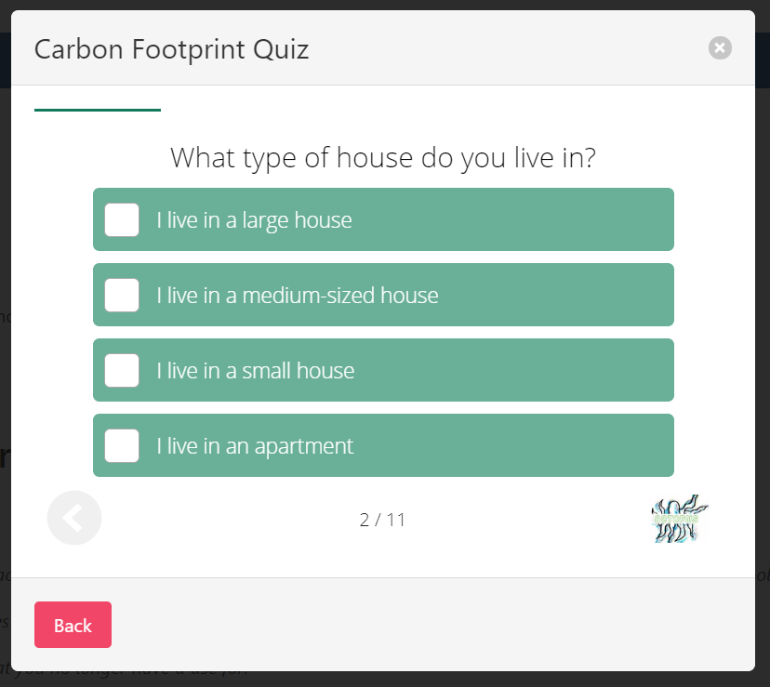
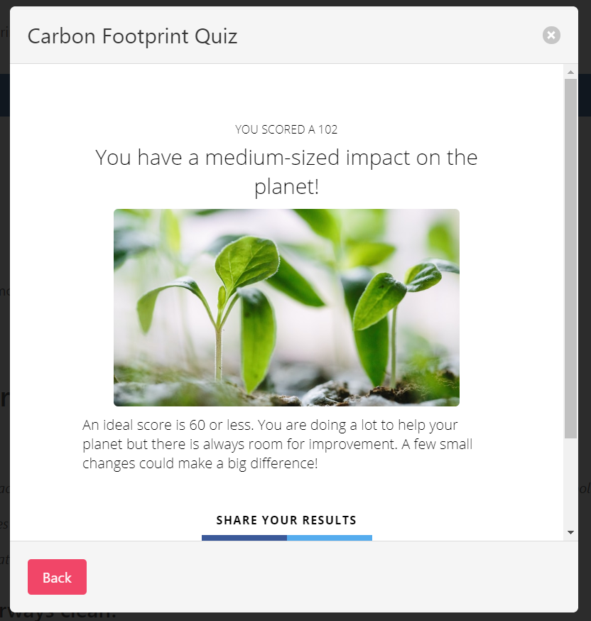
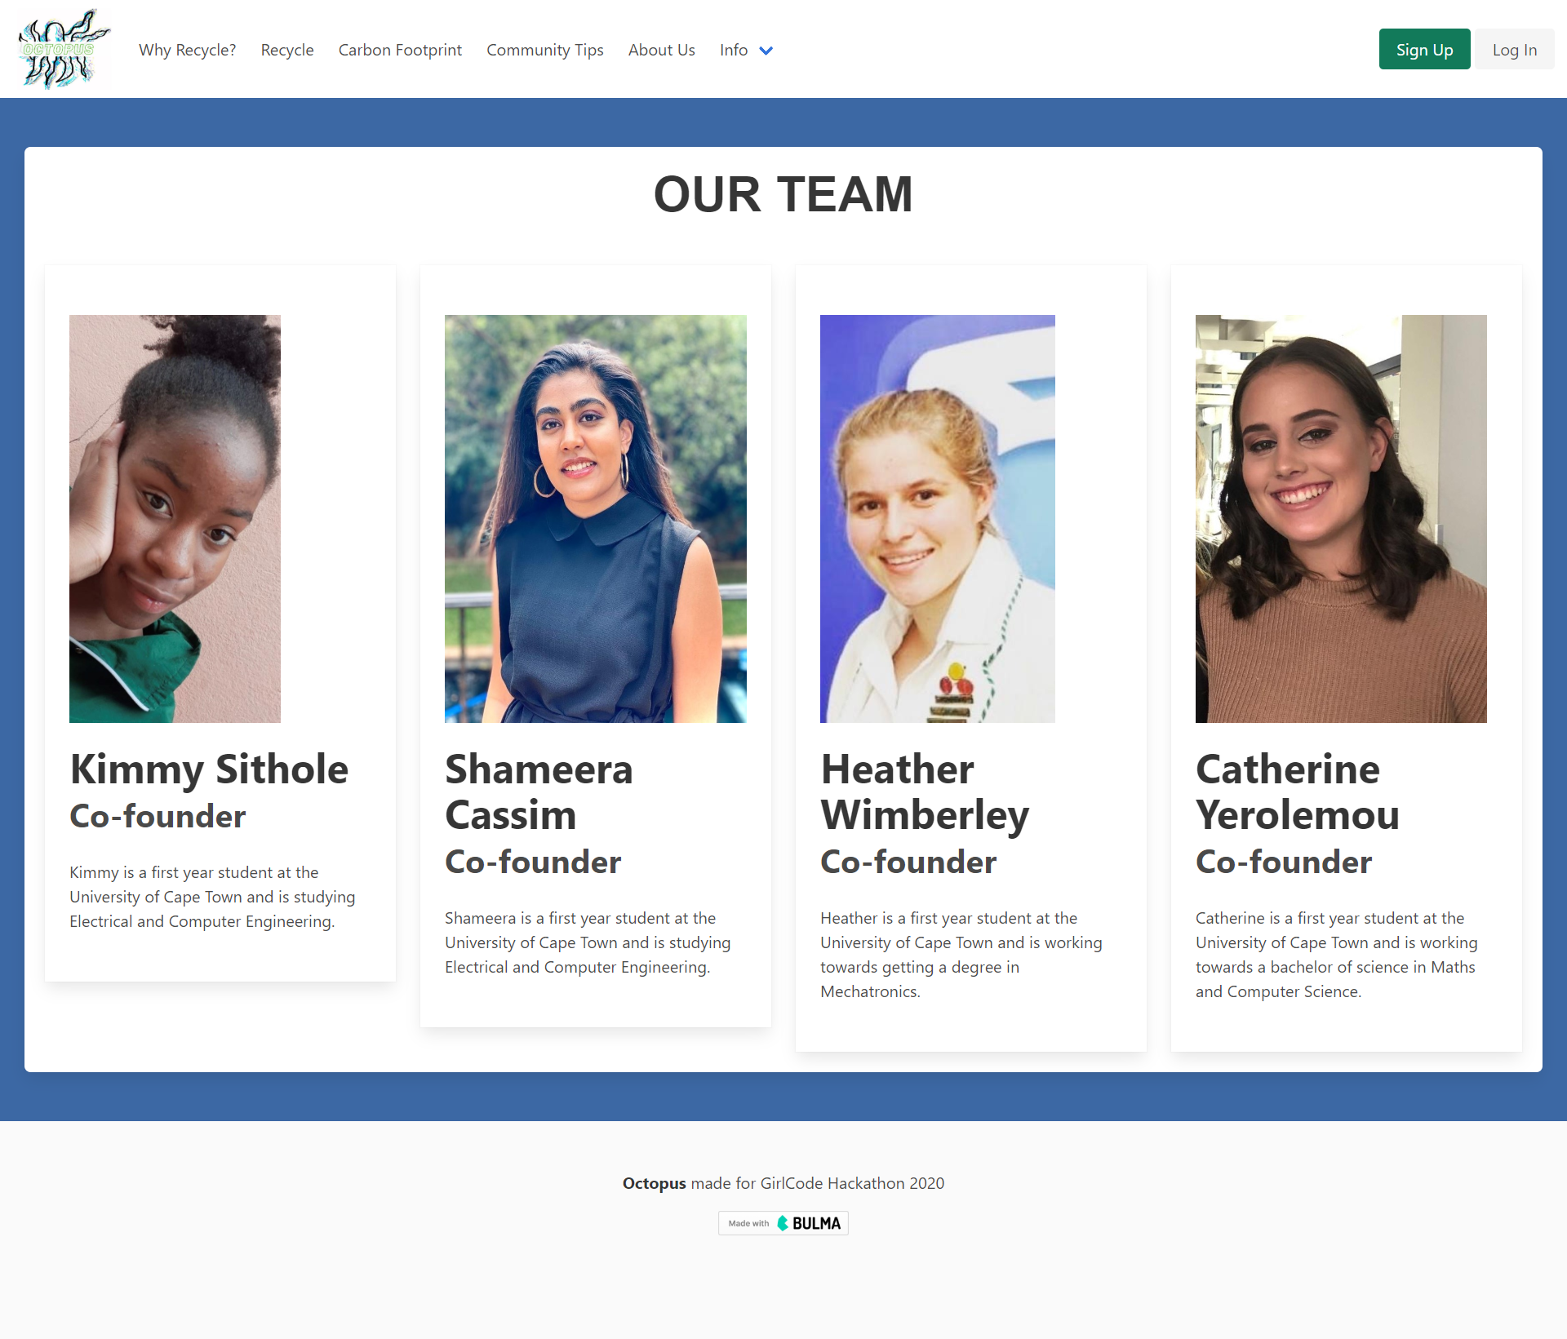
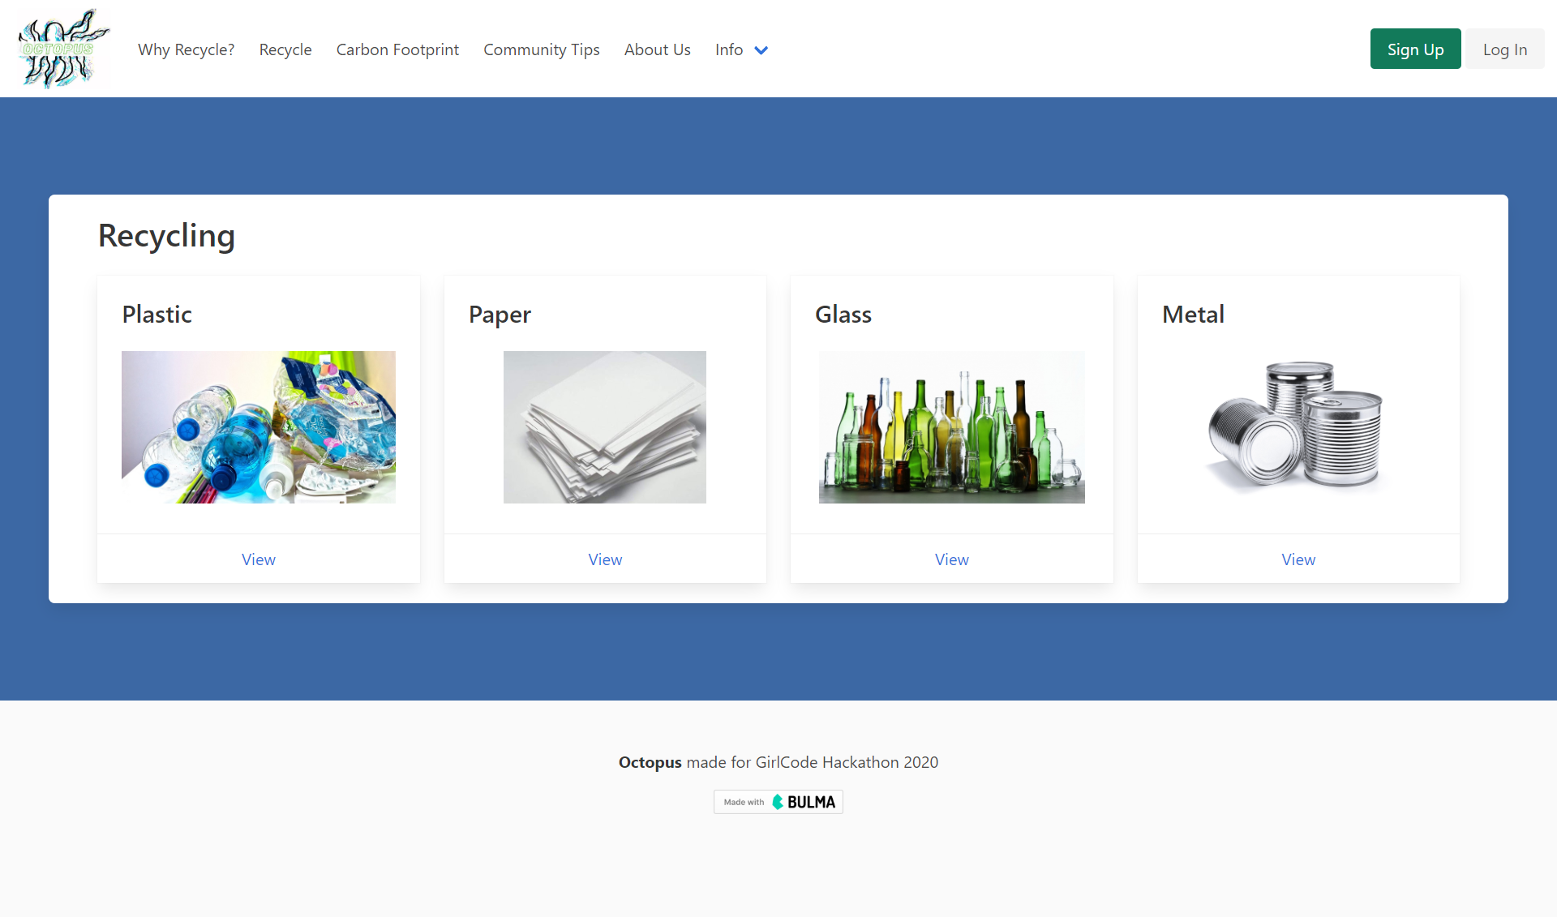
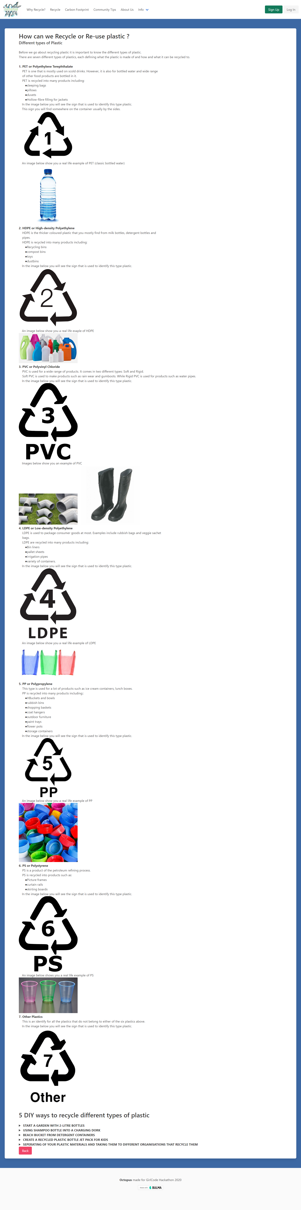
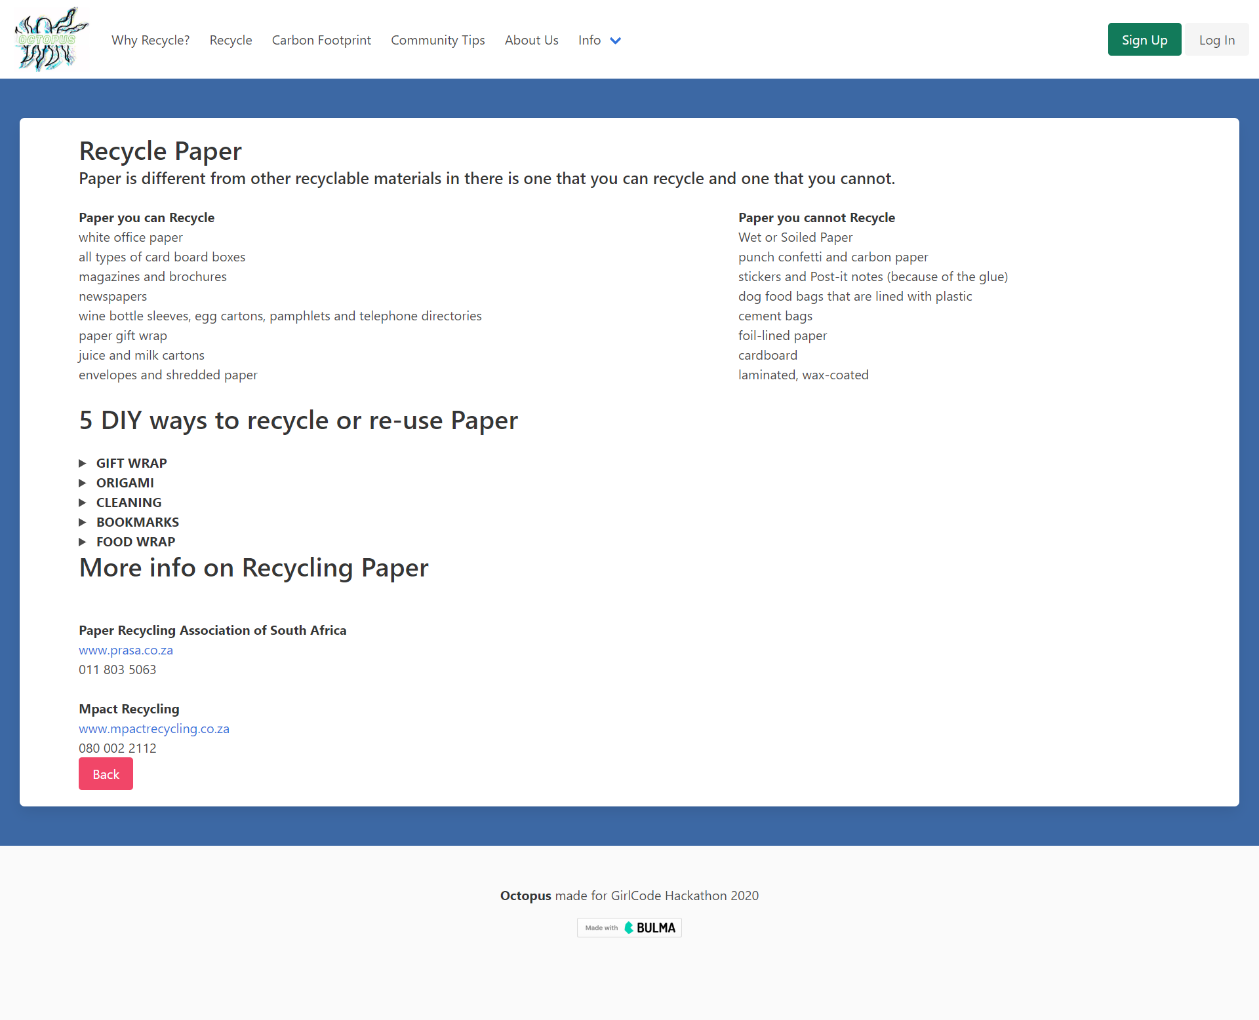
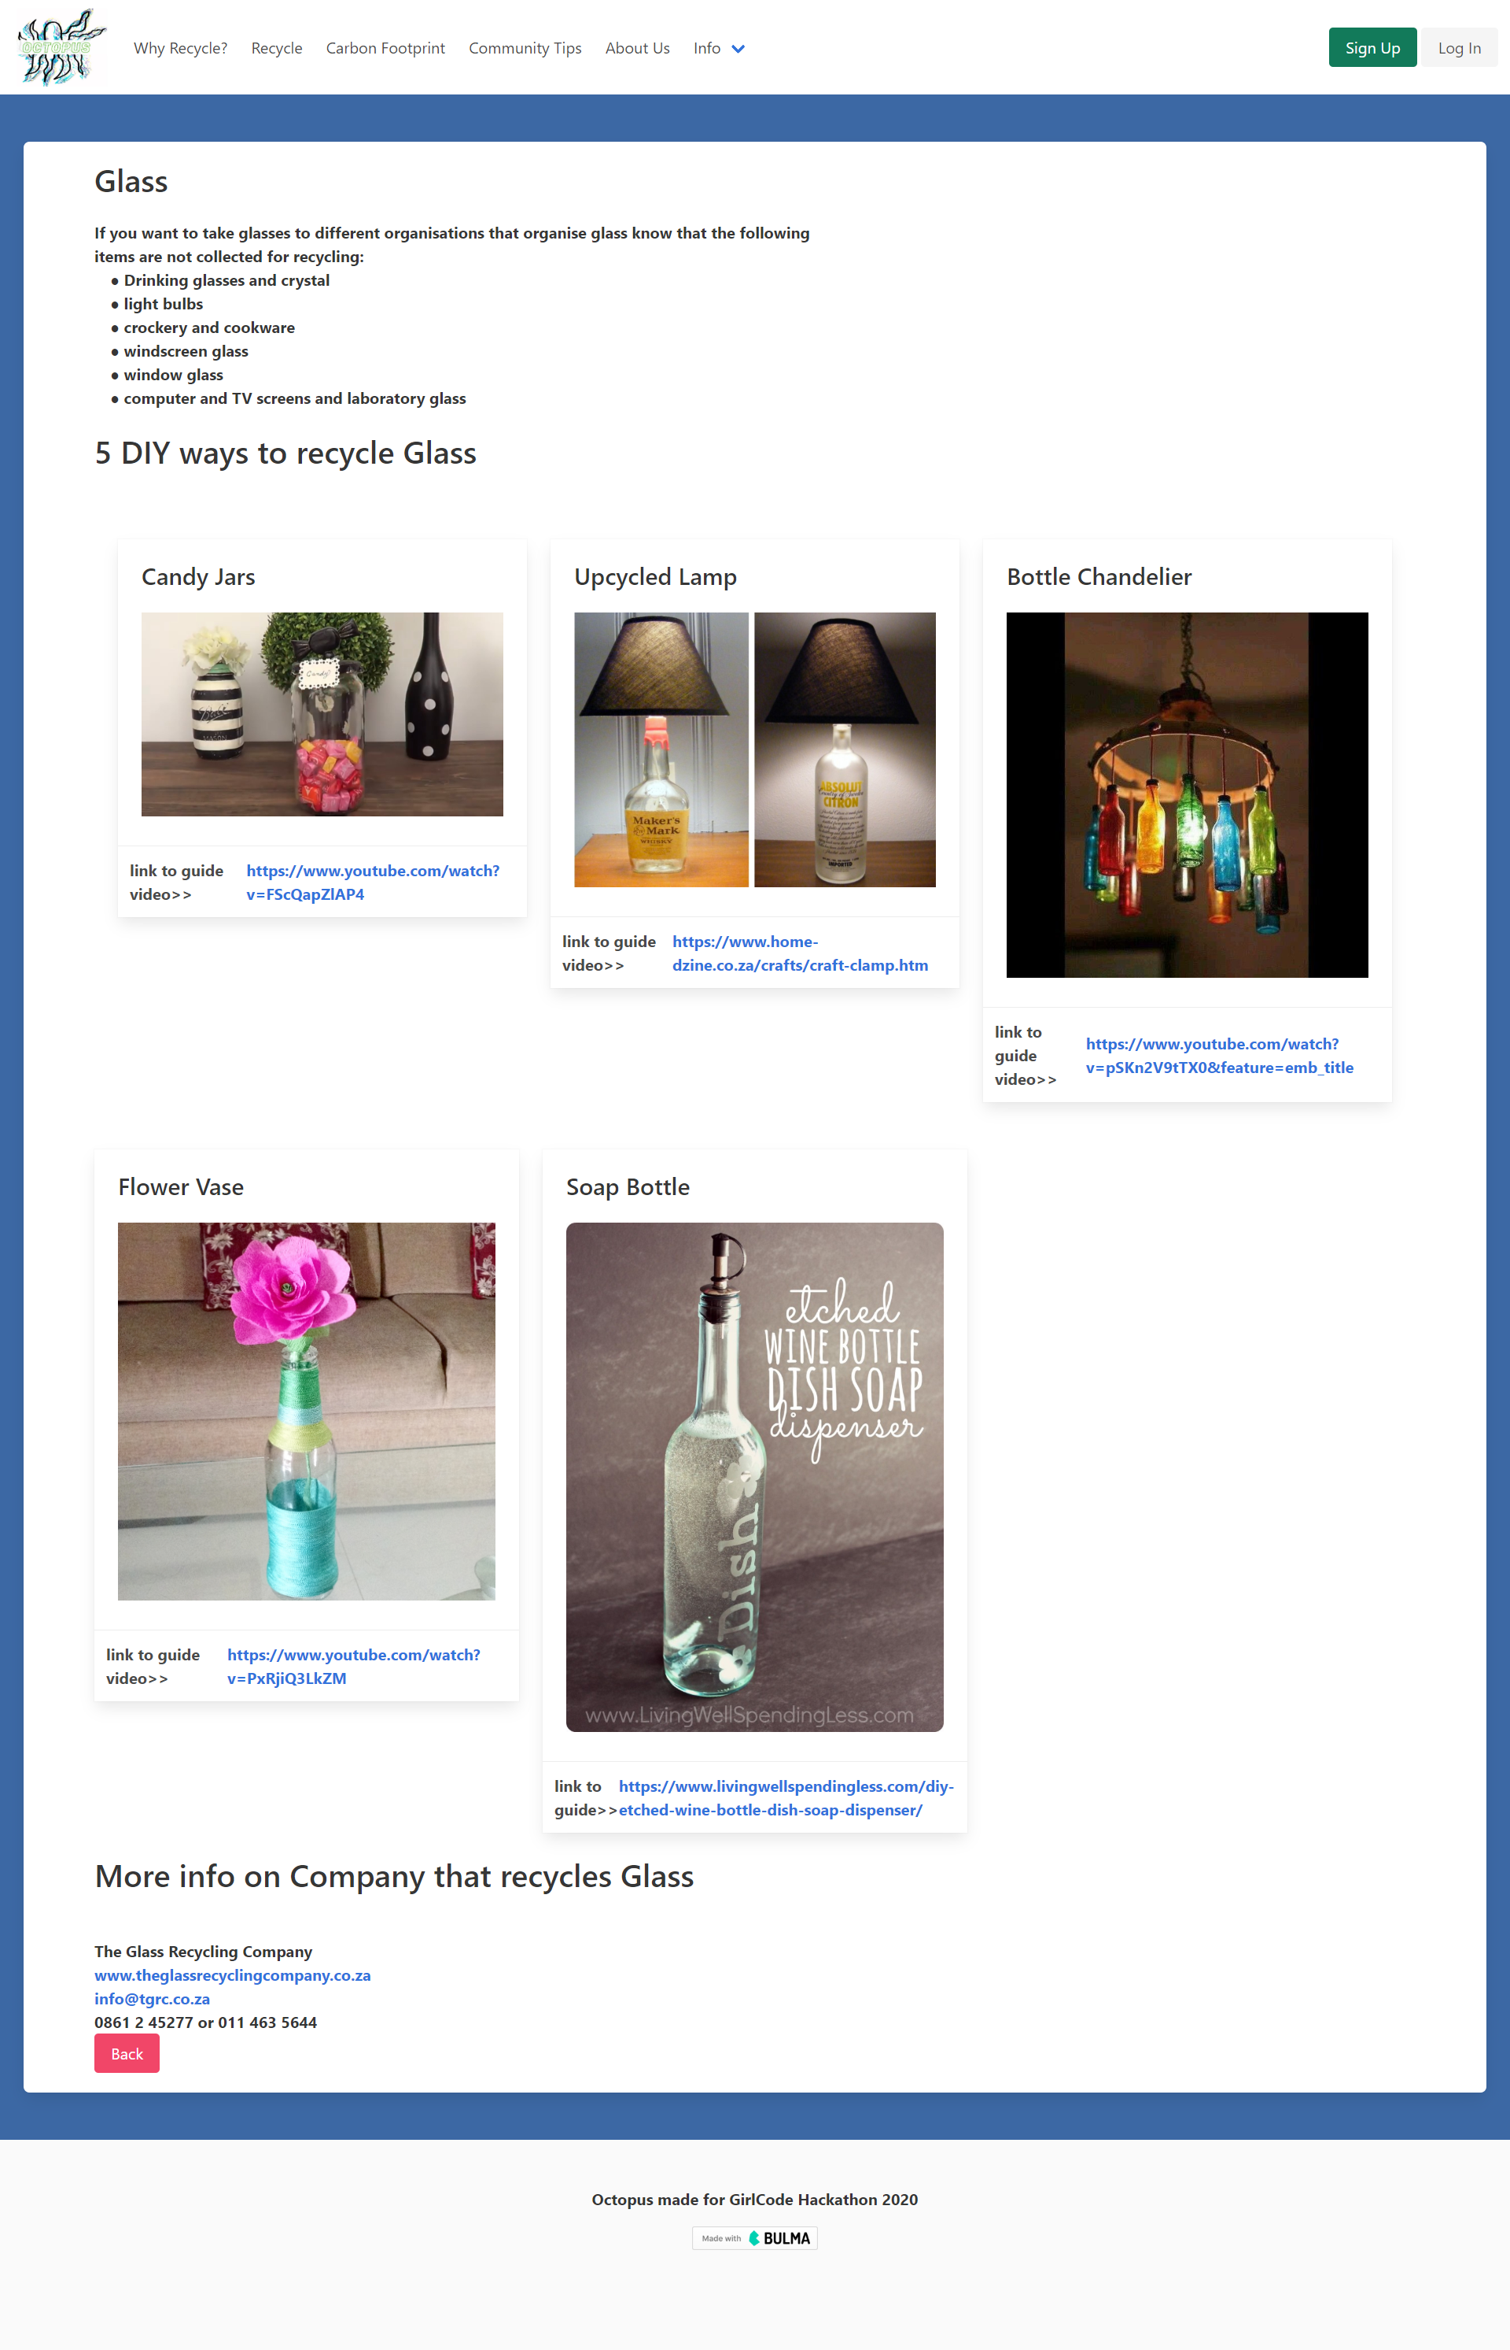
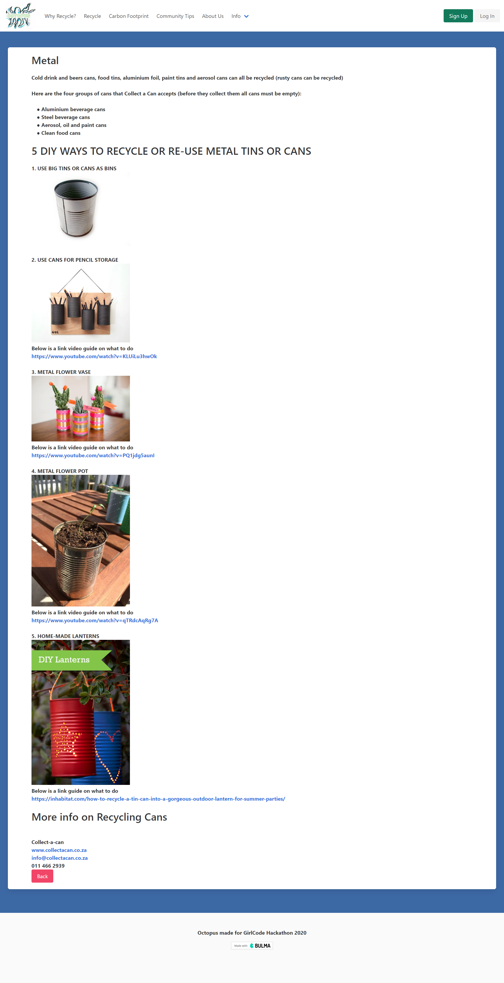
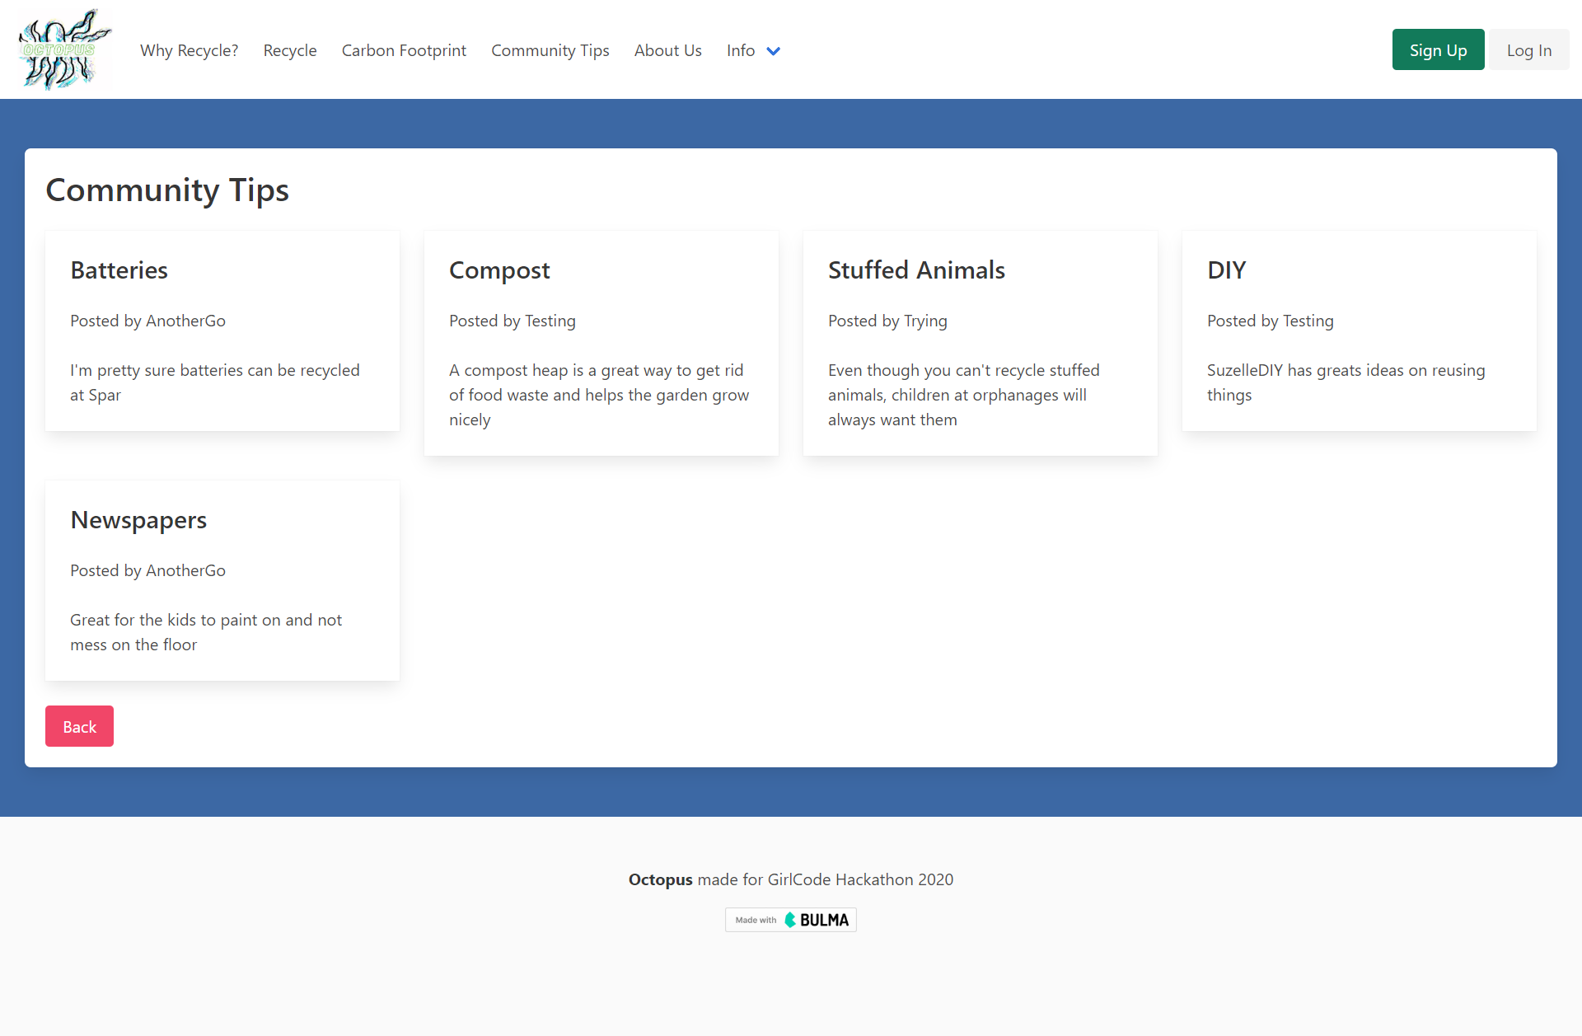
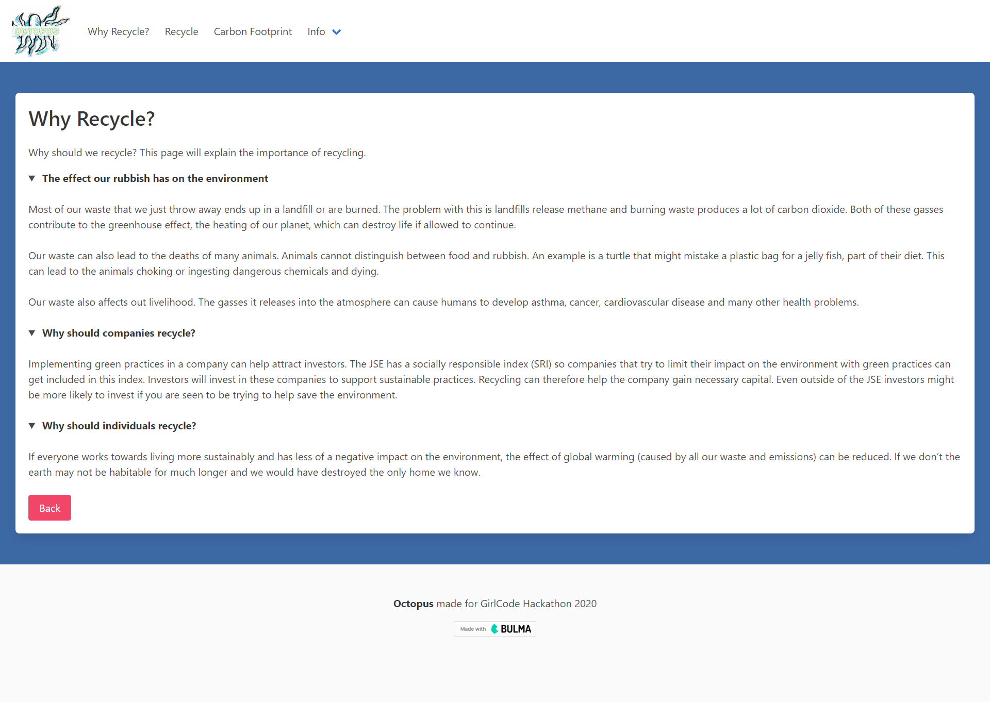
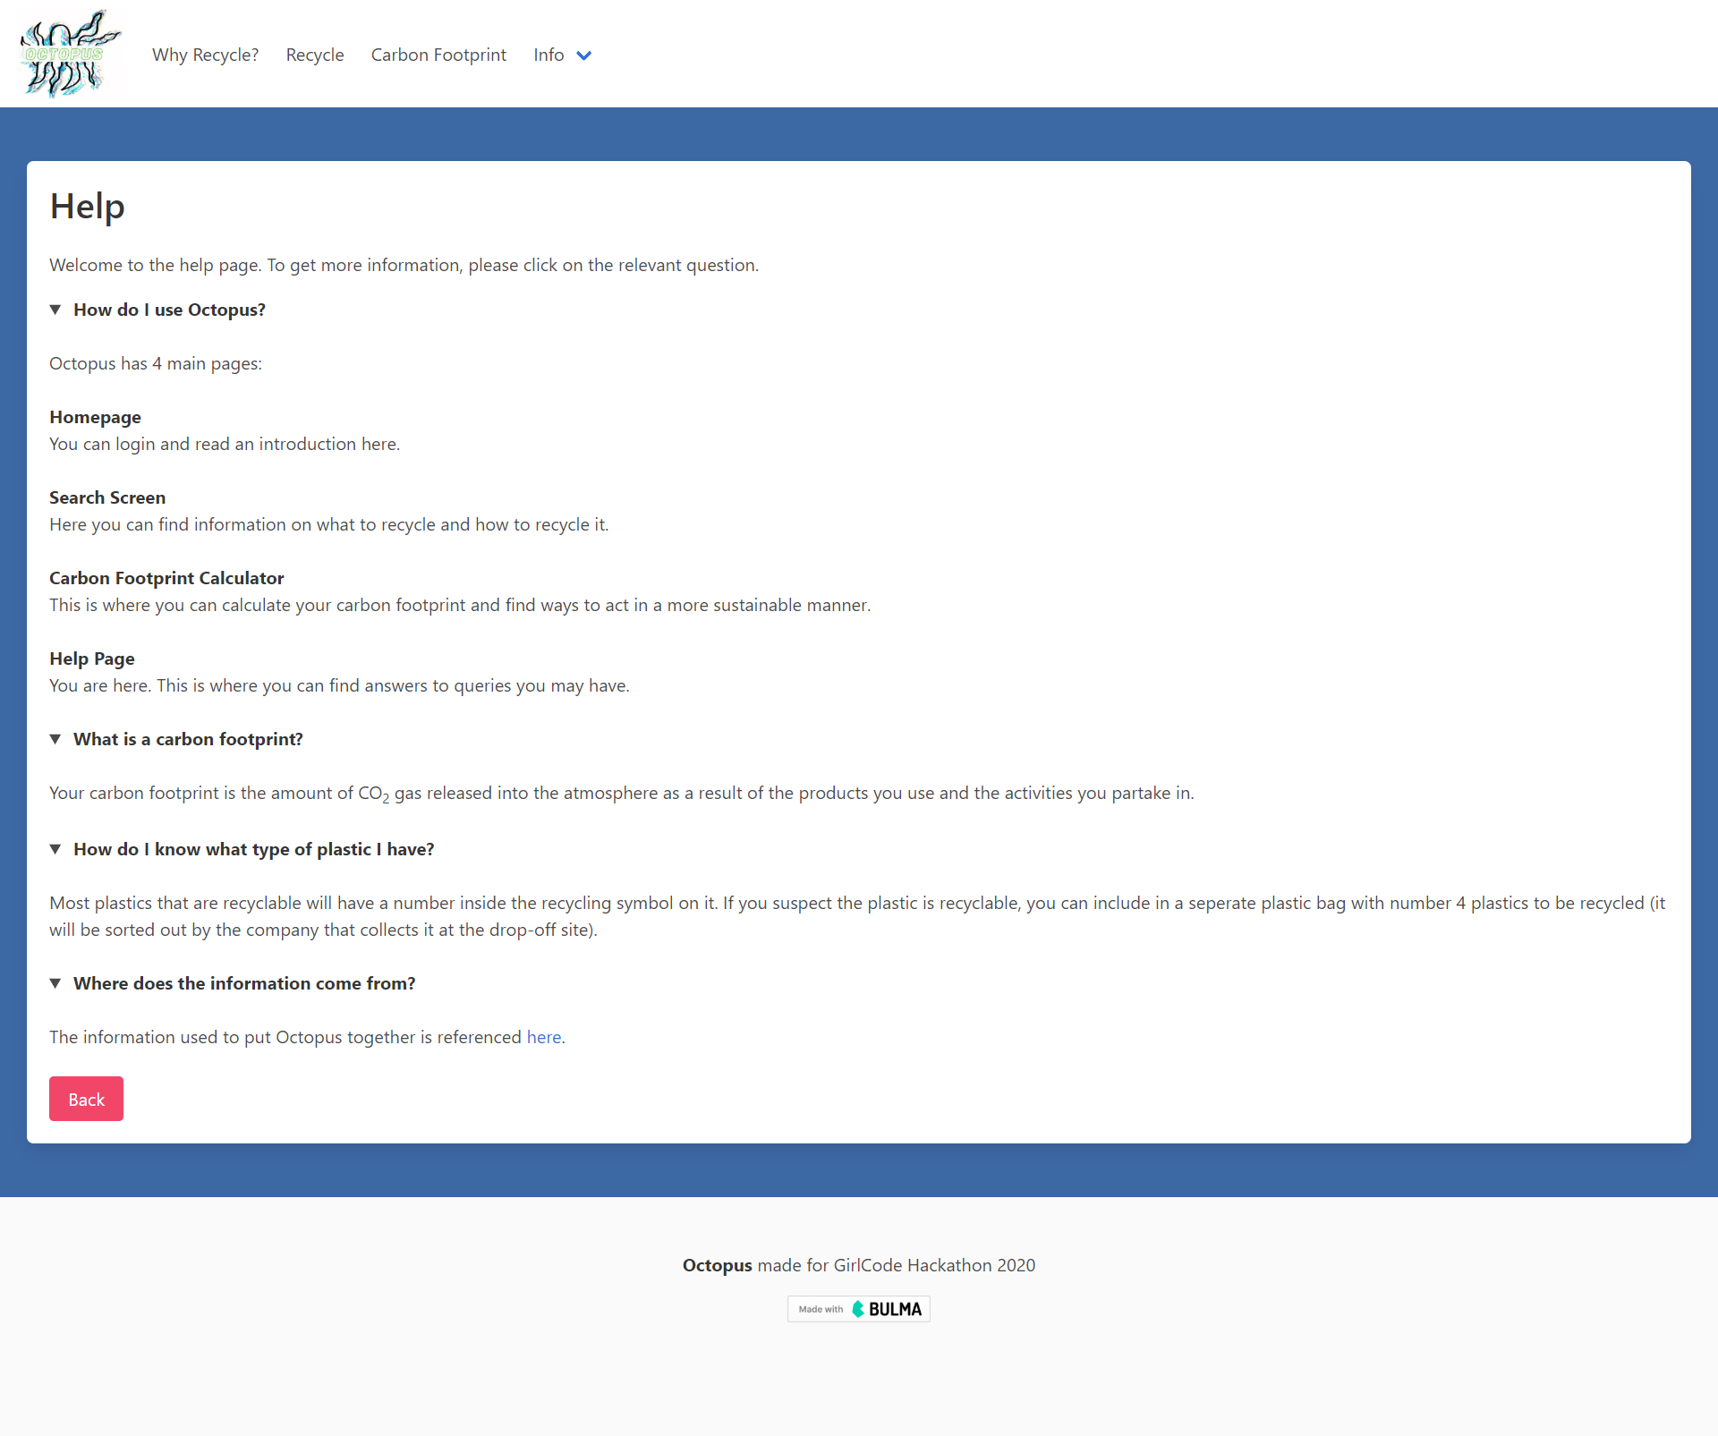
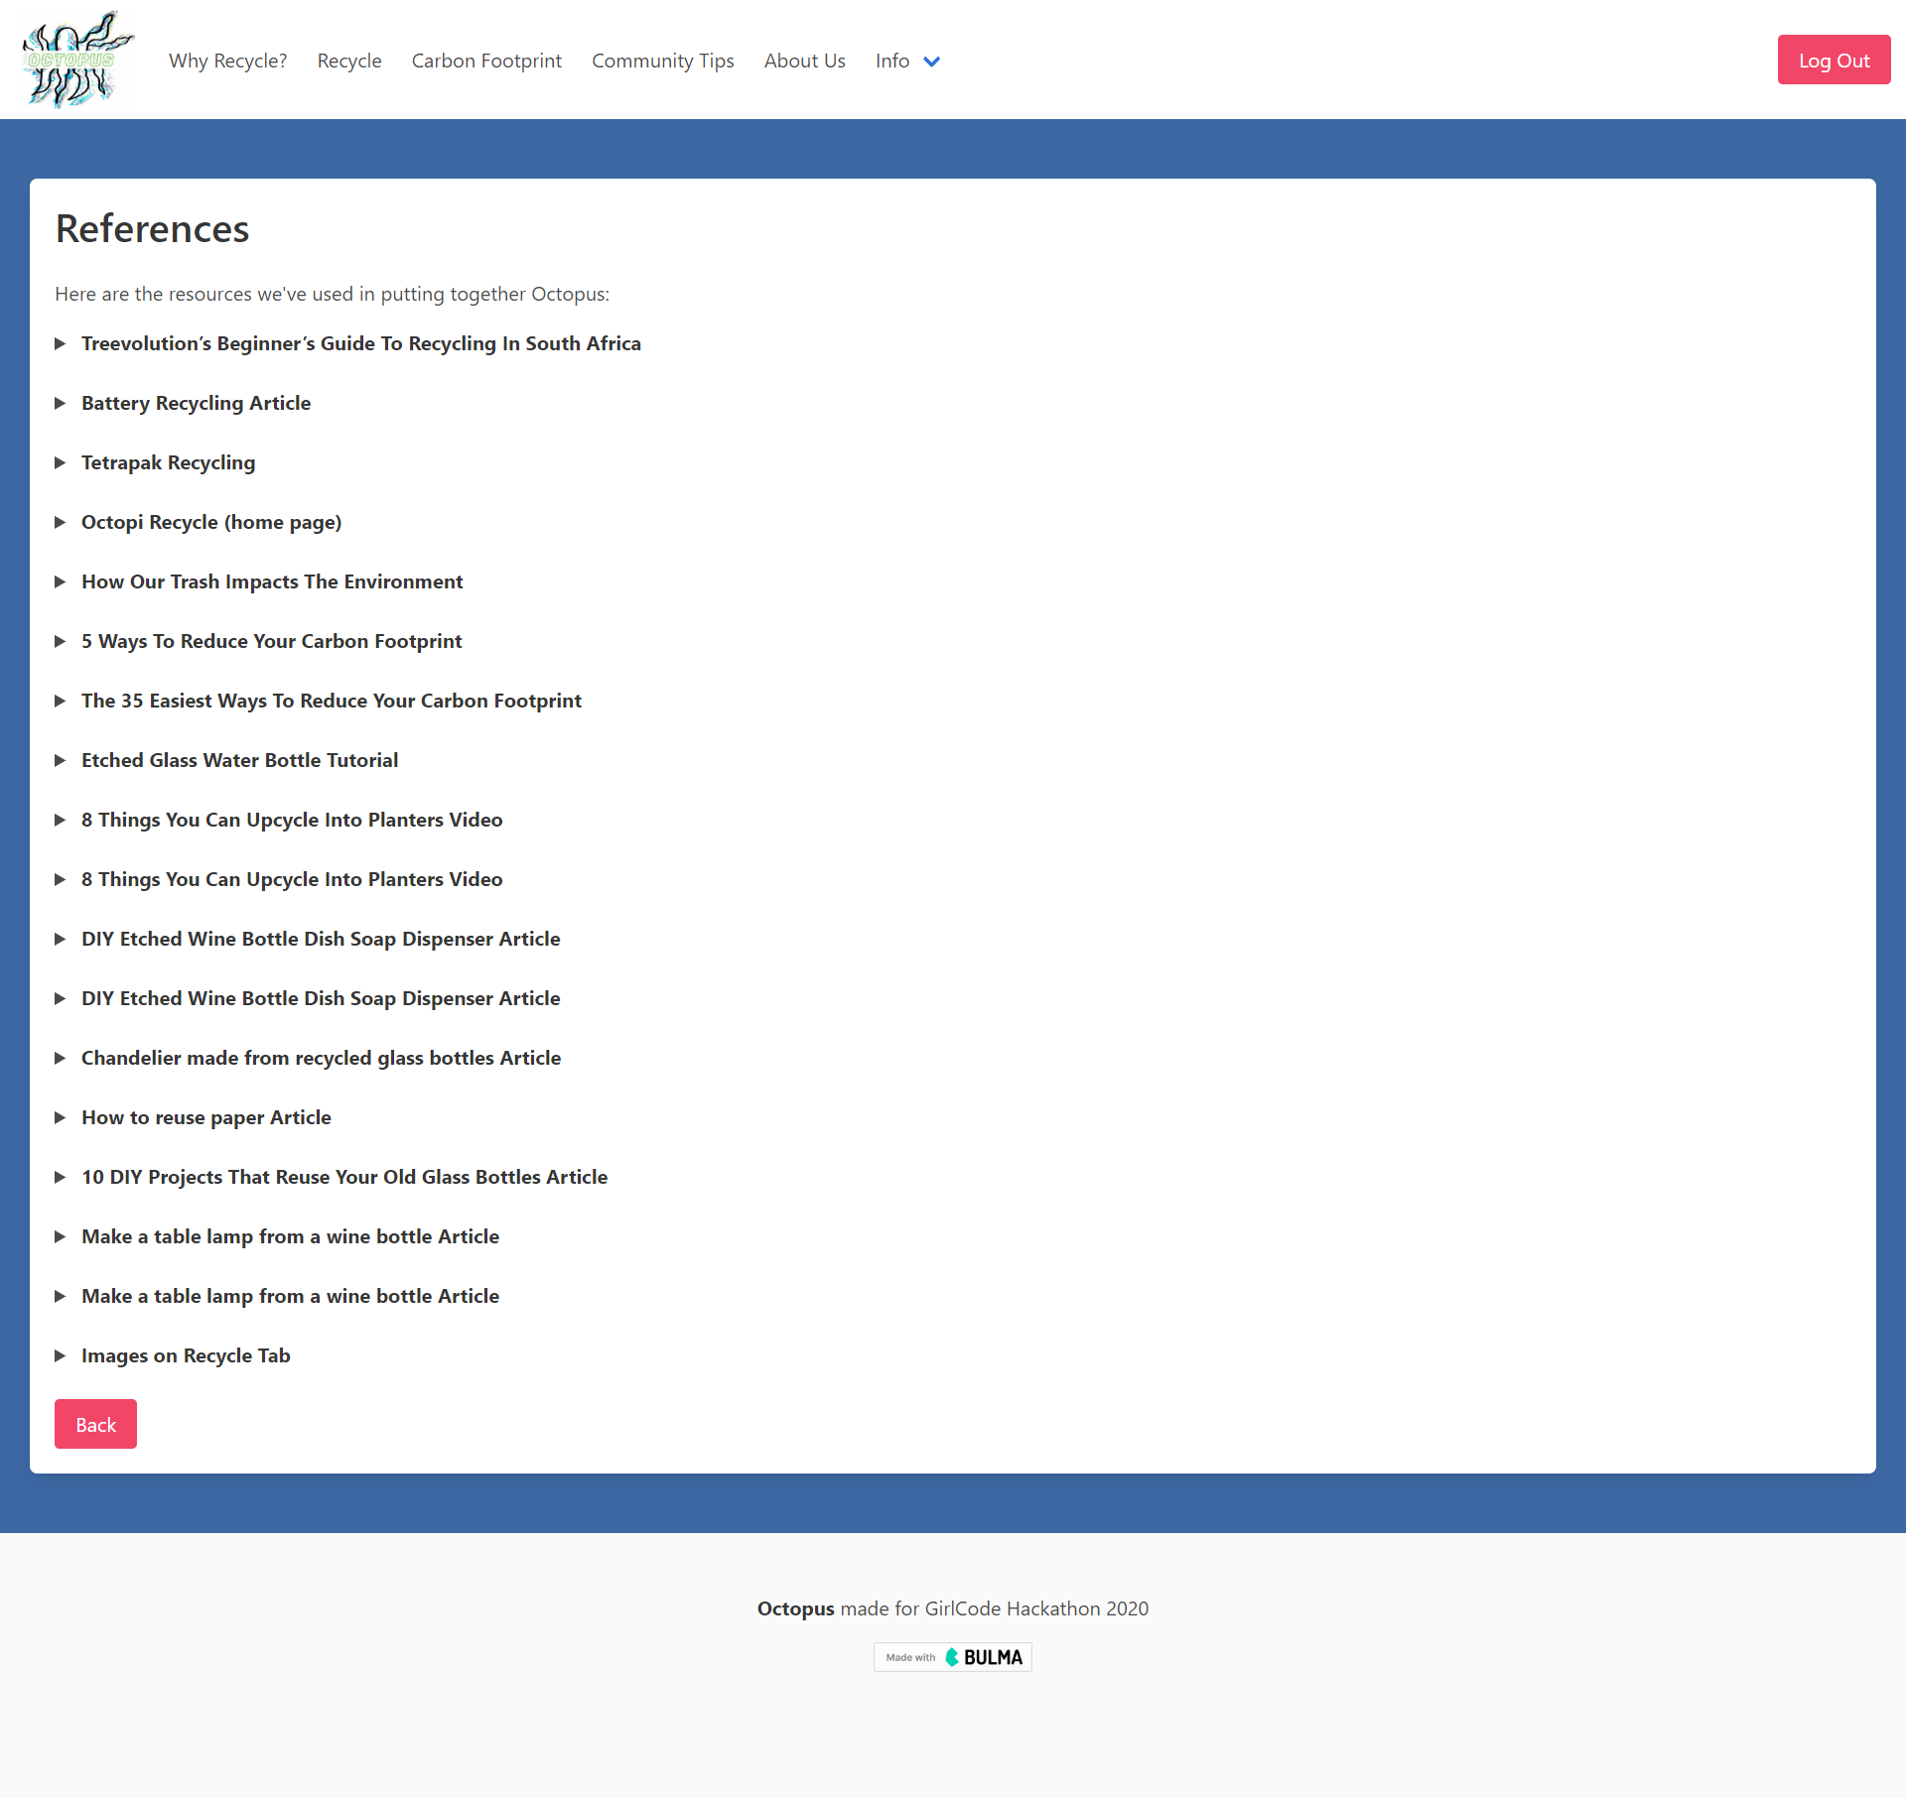
Why Octopus?
Octopi use recycled materials to build their homes in the ocean. Our aim is to protect our own home through recycling and encourage people to be more like octopi, hence the name, Octopus!
Homepage
Carbon footprint calculator
About Us
Recycle Page(s)
COMMUNITY PAGE
WHY RECYCLE?
HELP
REFERENCES

